Slide 1
5-Programming Constructs Switch Statement
Ibtisam Mogul

Slide 2
Switch-case Statement
Break
default

Slide 3


Slide 4
The Switch Statement
switch statement evaluates(checks) an expression then match the result to
one of several possible cases
Expression-variable whose value is to be matched
switch ( expression ){
case value1 :
statement-list1
case value2 :
statement-list2
case value3 :
statement-list3
case ...
}

Slide 5
The Switch Statement
Each case contains:
value and
list of statements
The flow of control transfers to statement associated with the first case value that matches
switch ( expression ){
case value1 :
statement-list1
case value2 :
statement-list2
case value3 :
statement-list3
case ...
}

Slide 6
Switch - syntax
switch
and
case
are
reserved
words
switch ( expression ){
case value1 :
statement-list1
case value2 :
statement-list2
case value3 :
statement-list3
case ...
}

Slide 7
Switch - syntax
The general syntax of a switch statement is:
switch
and
case
are
reserved
words
switch ( expression ){
case value1 :
statement-list1
case value2 :
statement-list2
case value3 :
statement-list3
case ...
}
If expression
matches value3,
control jumps
to here

Slide 8
break STATEMENT
break statement enables the program to skip over
the part of the code.
A break statement terminates the smallest
Enclosing { }
while, do-while, for or switch statement.

Slide 9
The Switch Statement
The break statement can be used as the last statement in each case's statement list
switch ( expression ){
case value1 :
statement-list1
break;
}
case value2 :
statement-list2
break;
case value3 :
statement-list3
break;
case ...
A break statement causes control to transfer to the end of the switch statement
If a break statement is not used, the flow of control will continue into the next case

Slide 10
Switch
switch(option)
{ case ‘a’: ……
..….
break;
case ‘b’ : ……
..….
break;
case ‘c’: ……
..….
break;
default : ……
..….
break;
} //end of switch body

Slide 11
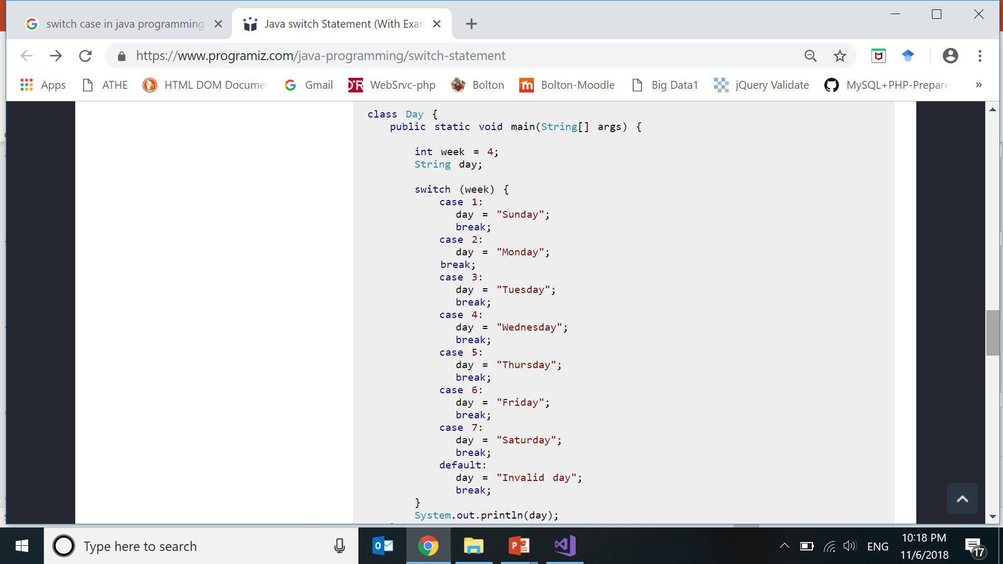
Notes:
https://www.programiz.com/java-programming/switch-statement

Slide 12
Switch Example
int daynum= 4;
String day;
switch (daynum){
case 1:
day=“Sunday”;
break;
case 2:
day=“Monday”;
break;
case 3:
day=“Tuesday”;
break;
case 4:
day=“Wednesday”;
break;
}
MessageBox.Show(day);
case 5:
day=“Thursday”;
break;
case 7:
day=“Saturday”;
break;
Notes:
https://www.programiz.com/java-programming/switch-statement

Slide 13
Switch Example
option= 4;
switch (option){
case 1:
day=“Sunday”;
break;
case 2:
day=“Monday”;
break;
case 3:
day=“Tuesday”;
break;
case 4:
day=“Wednesday”;
break;
case 5:
day=“Thursday”;
break;
case 6:
day=“Friday”;
break;
case 7:
day=“Saturday”;
break;
}
MessageBox.Show(aCount, bCount,cCount);

Slide 14
Switch Example No breaks
option= 4;
switch (option){
case 1:
day=“Sunday”;
break;
case 2:
day=“Monday”;
break;
case 3:
day=“Tuesday”;
break;
case 4:
day=“Wednesday”;
break;
case 5:
day=“Thursday”;
break;
case 7:
day=“Saturday”;
break;
}
MessageBox.Show(day);
option= 4;
switch (option){
case 1:
day=“Sunday”;
case 2:
day=“Monday”;
case 3:
day=“Tuesday”;
case 4:
day=“Wednesday”;
case 5:
day=“Thursday”;
case 7:
day=“Saturday”;
}
MessageBox.Show(day);

Slide 15
Switch - default
A switch statement can have an optional default case
default case has no associated value
default statement gets executed
when there is no match found.
The default is optional, and if it is missing then no action takes place if all matches fail.

Slide 16
Switch Default Example
option= 10;
switch (option){
case 1:
day=“Sunday”;
break;
case 2:
day=“Monday”;
break;
case 4:
day=“Wednesday”;
break;
case 5:
day=“Thursday”;
break;
case 7:
day=“Saturday”;
break;
default:
day=“Invalid”;
break;
}
MessageBox.Show(day);

Slide 17
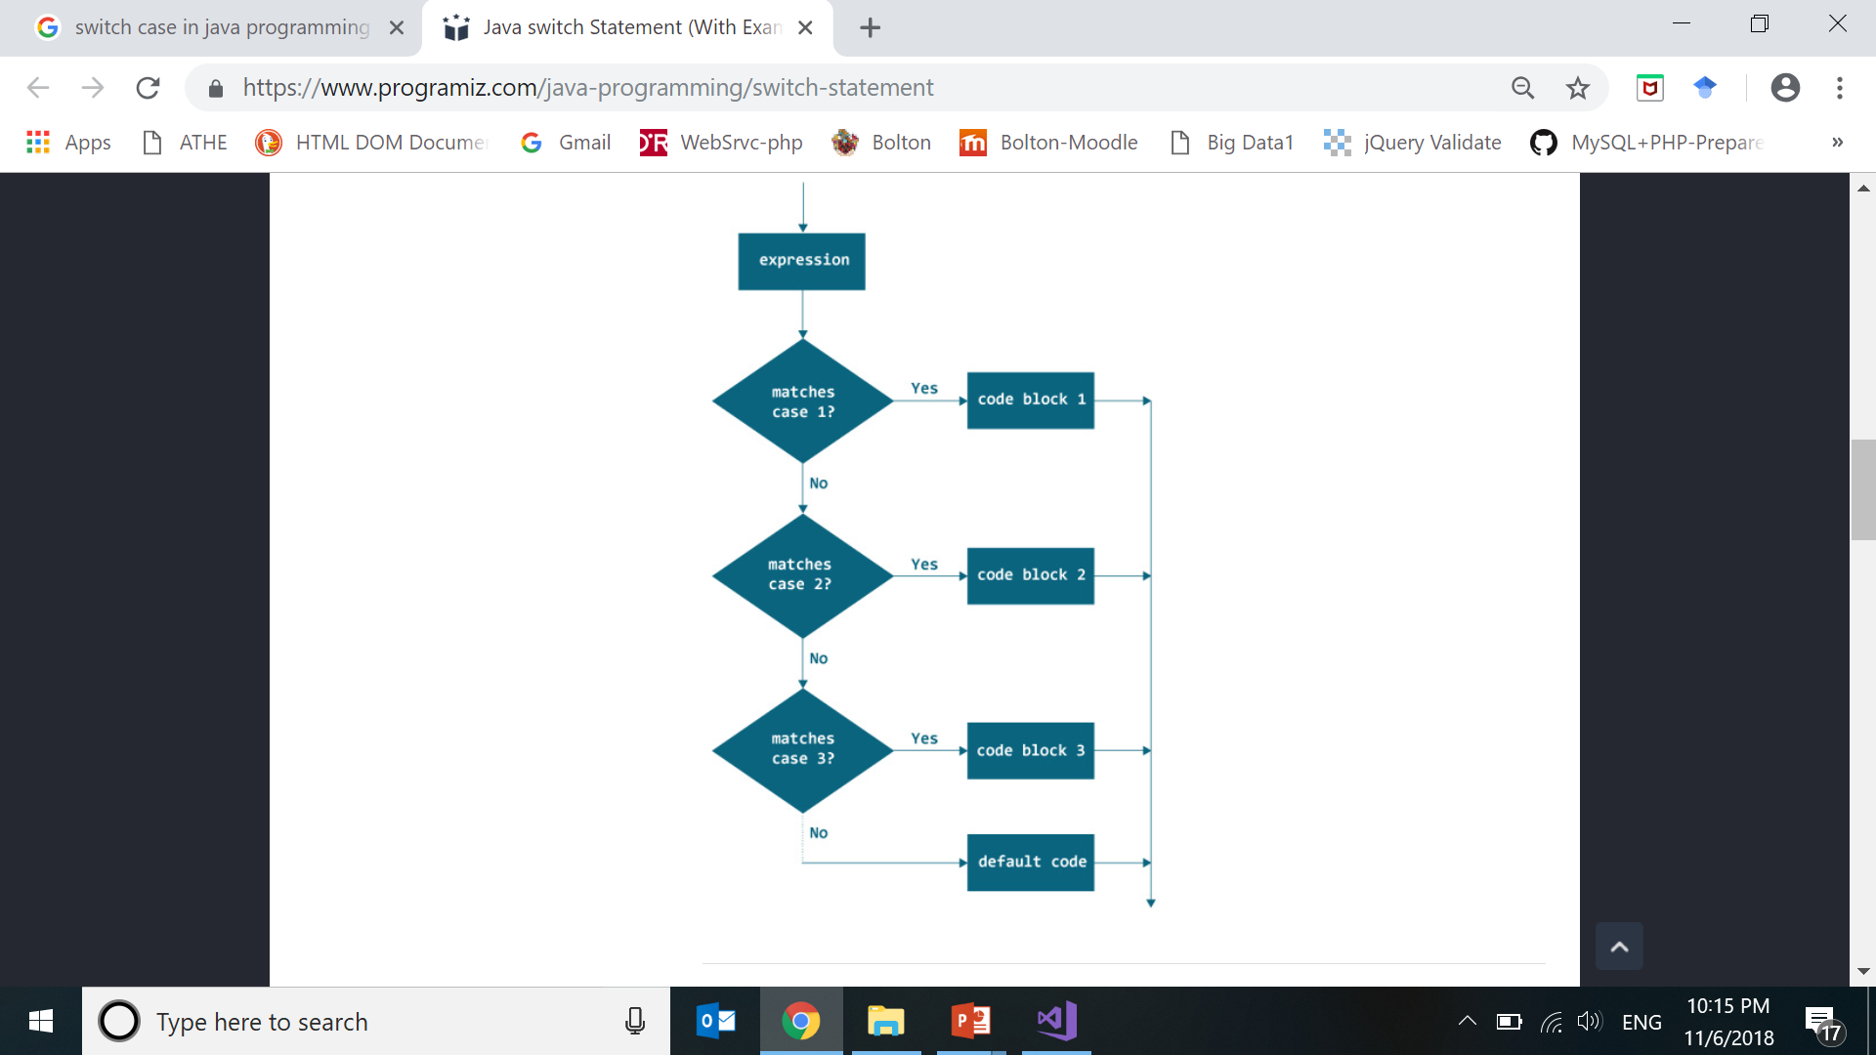
FLOWCHART OF SWITCH
Notes:
https://www.programiz.com/java-programming/switch-statement

Slide 18
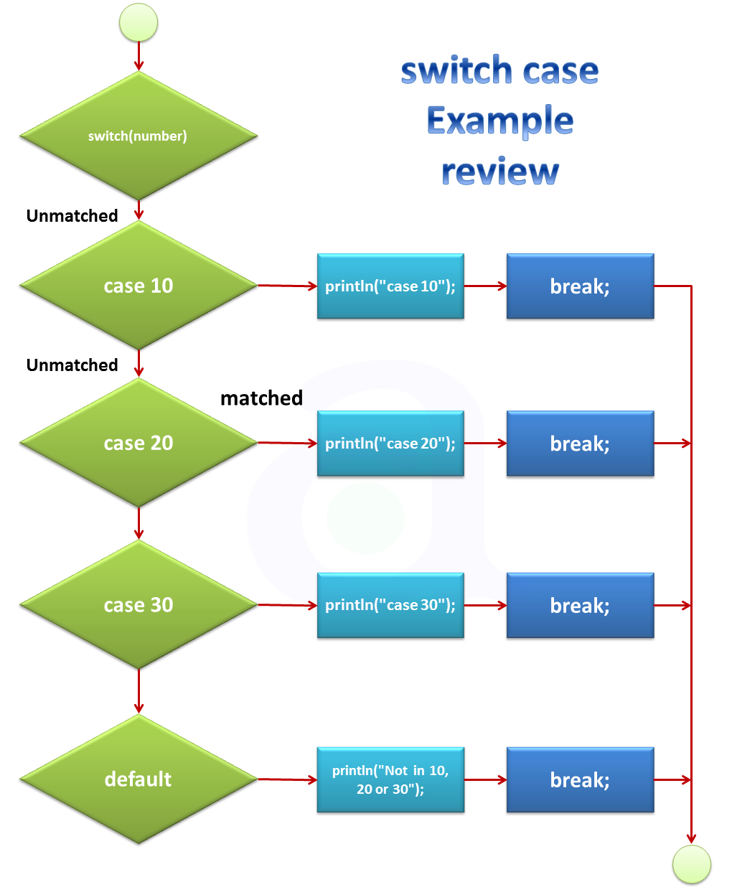

Slide 19
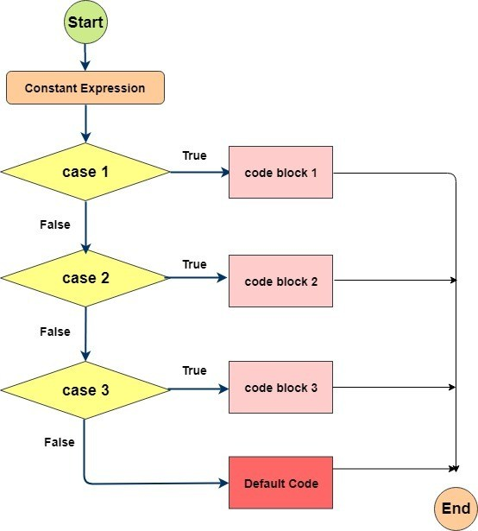

Slide 20
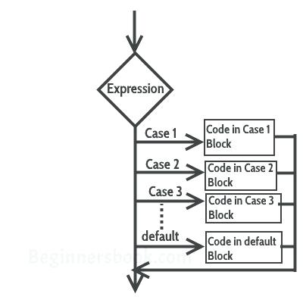

Slide 21
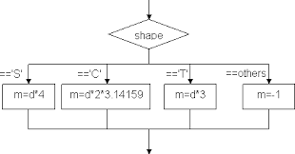

Slide 22
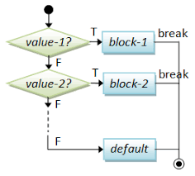

Slide 23
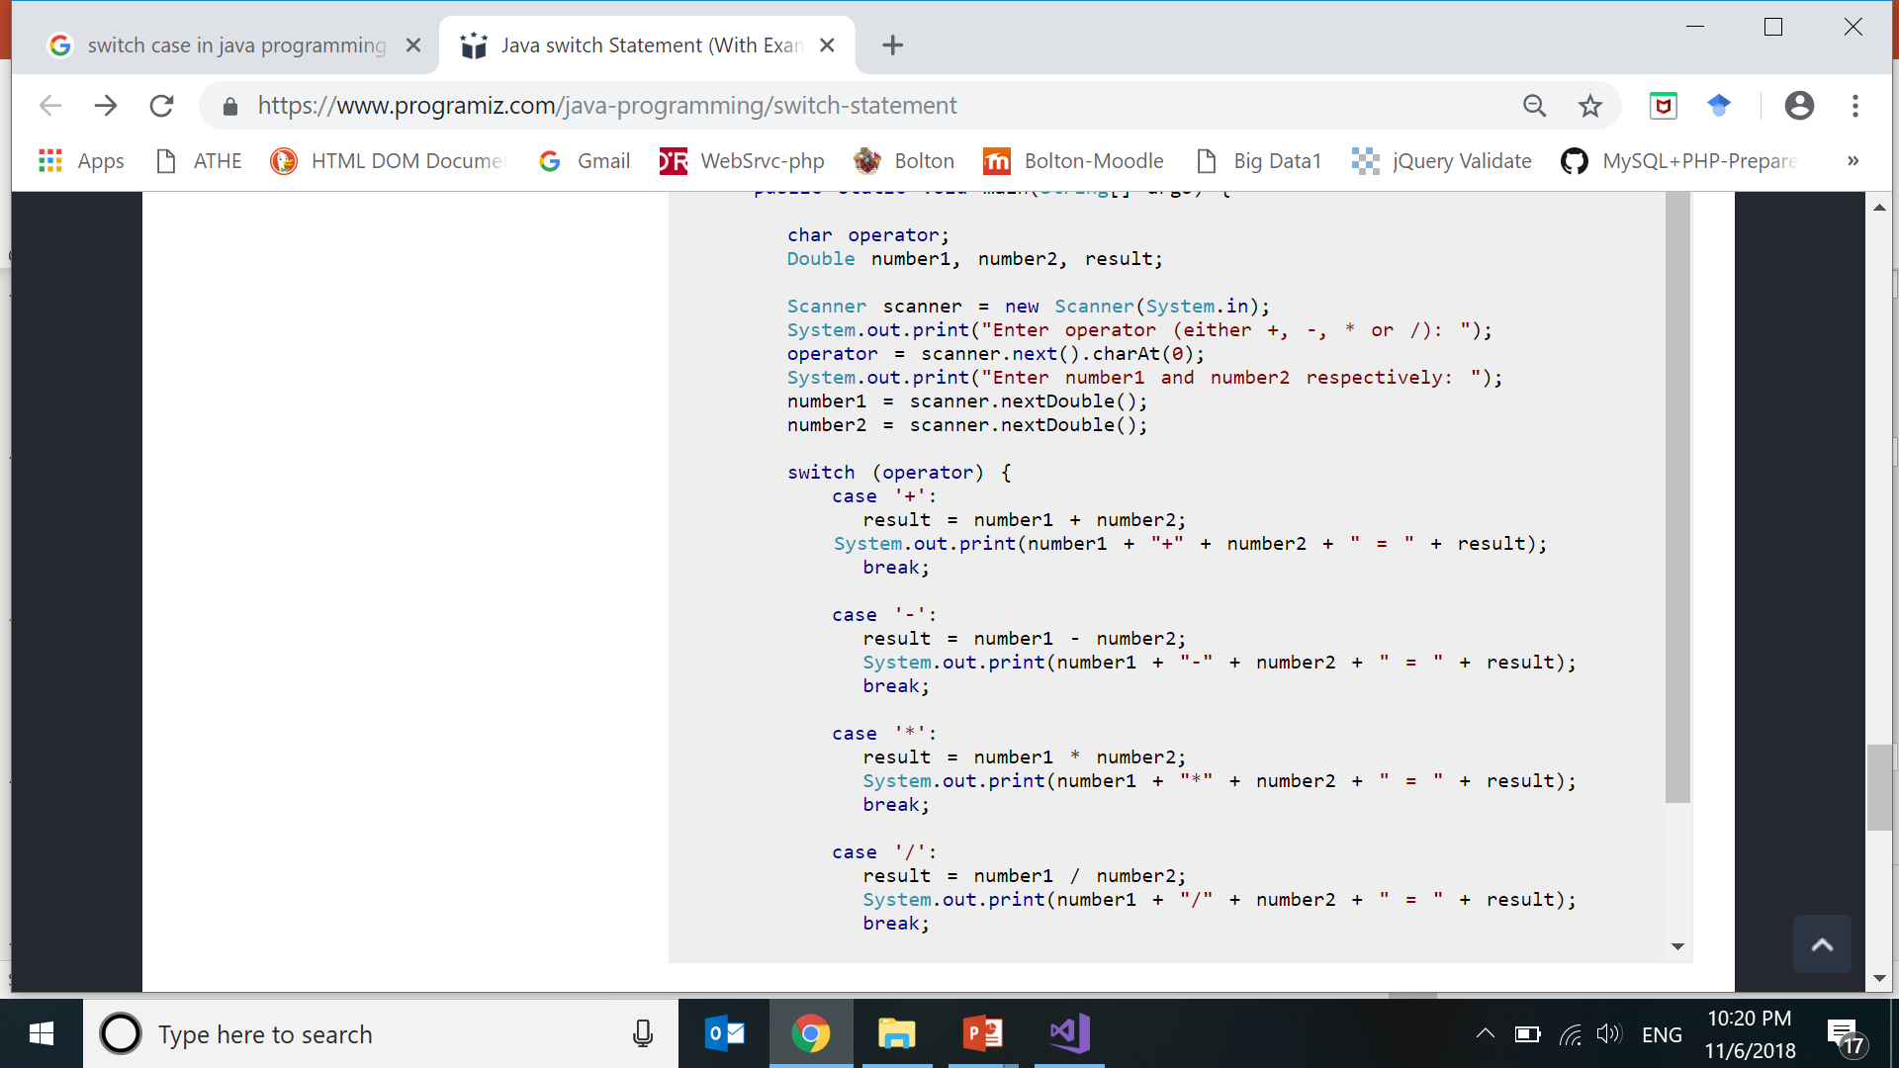


Slide 24
THE switch STATEMENT
Multiple- branch selection statement
successively tests the value of an expression
against
the list of integer or character constants.
When a match is found,
the statements associated with that construct are executed.

Slide 25
switch Statement
Syntax:
switch( expression )
{
case value1 :
statement sequence 1;
break;
case value2 :
statement sequence 2;
break;
case valuen:
statement sequence n;
break;
default:
statement sequence n+1;
}

Slide 26
switch Statement
Evaluate expression
Compare its value with the values(value1…valuen)
of the constants specified in the case statements.
When the match is found,
the statement sequence of that case is executed
until the break statement.

Slide 27
switch Statement- without break
If a case statement does not include break statement
then
the control continues on the next case statement(s)
until either a break is encountered or
end of switch is reached this situation.

Slide 28
Switch Rules
The switch statement selects its branches by testing the value of same variable (against the set of constants)
case labels of switch must be an integer or character.
Each switch case label must be a
single value.
switch cannot handle floating point tests.

Slide 29
NOTE
Always put break statement after the last statement of each case in switch.

Slide 30
Select Shape and Calculate Area. (Circle, Square, Rectangle)

Slide 31
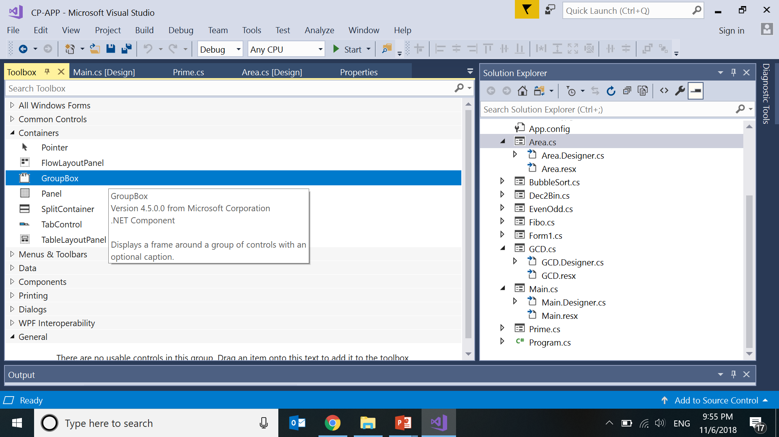

Slide 32
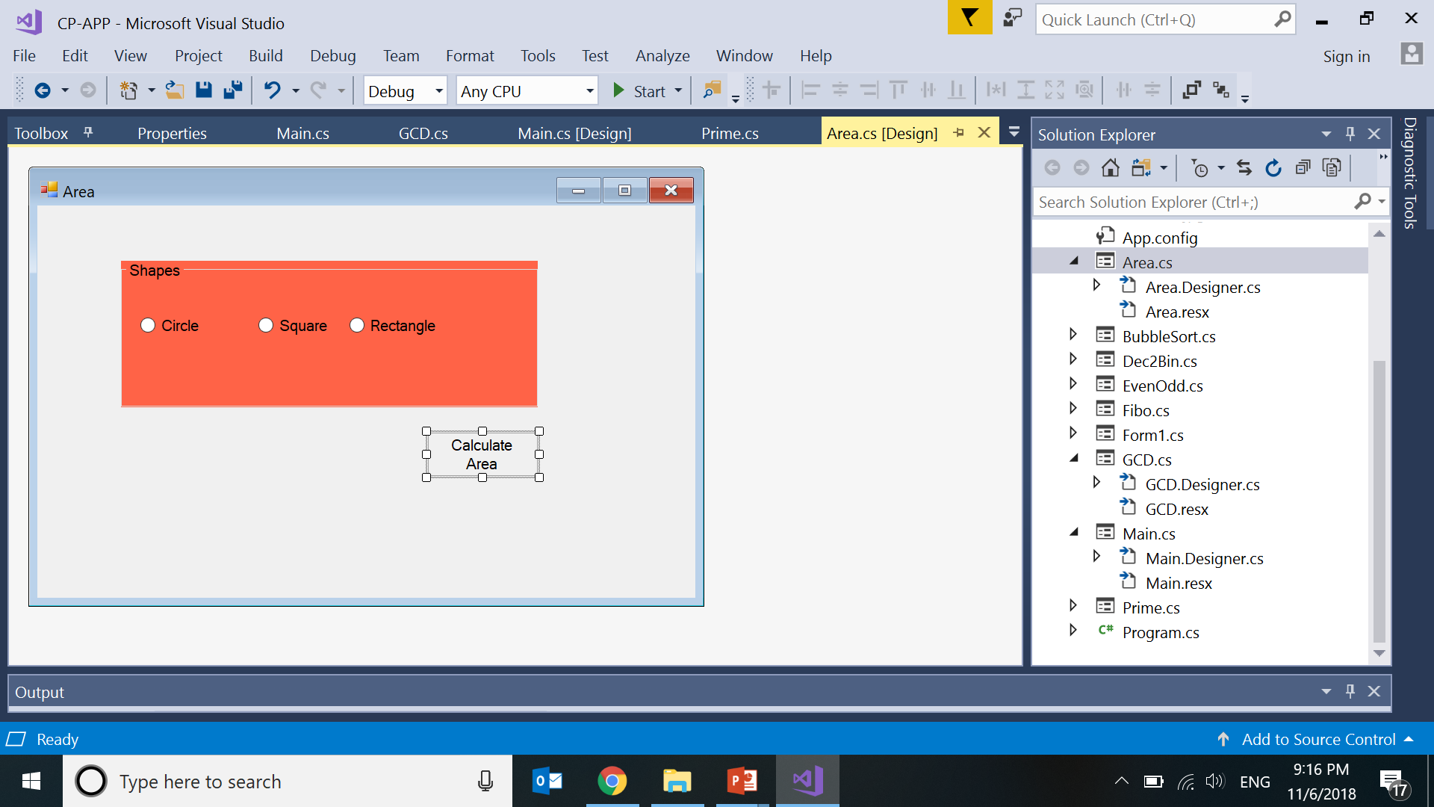
Area of Shapes

Slide 33
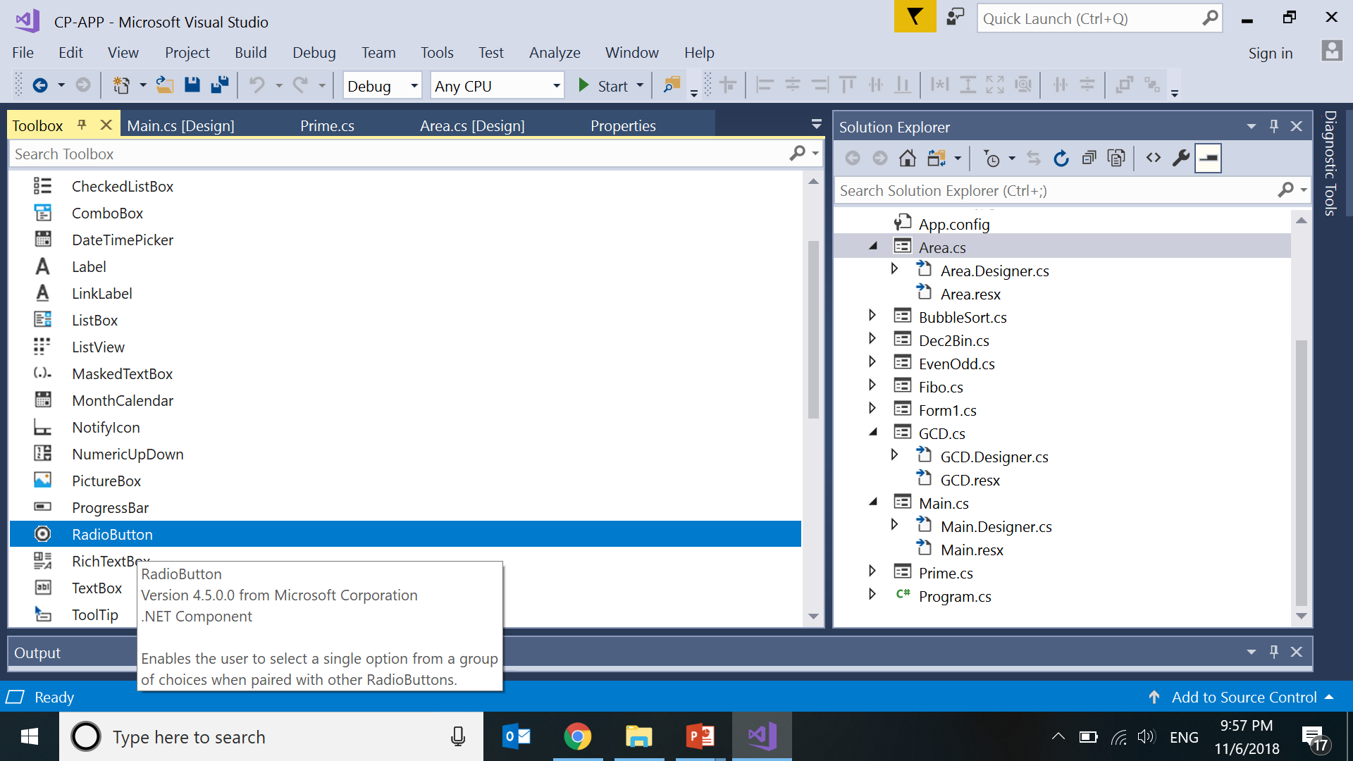

Slide 34
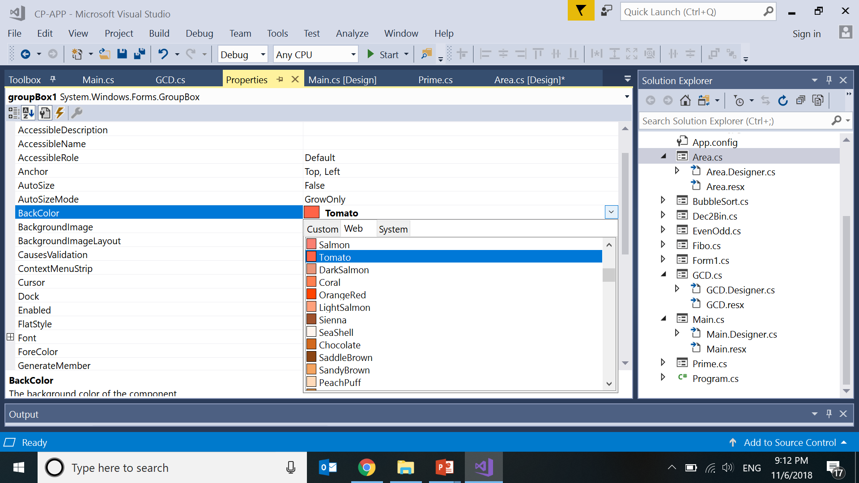

Slide 35
private void btnarea_Click(object sender, EventArgs e)
{
int shape = 0;
string input, inputb;
int length, breadth, side, radius;
double area;
if (radioButton1.Checked == true)
shape = 1;
else if (radioButton2.Checked == true)
shape = 2;
else if (radioButton3.Checked == true)
shape = 3;

Slide 36
switch (shape)
{
case 1:
input = Microsoft.VisualBasic.Interaction.InputBox("Enter Radius",
"Area of Circle","0",0, 0);
radius = Convert.ToInt32(input);
area = Convert.ToDouble(3.14 * radius*radius);
MessageBox.Show(Convert.ToString(area));
break;
case 2:
input =
Microsoft.VisualBasic.Interaction.InputBox("Enter Side of a Square",
"Area of Square","0",0,0);
side = Convert.ToInt32(input);
area = Convert.ToDouble(side*side);
MessageBox.Show(Convert.ToString(area));
break;
case 3:
input =
Microsoft.VisualBasic.Interaction.InputBox("Enter Length",
"Area of Square", "0", 0, 0);
inputb = Microsoft.VisualBasic.Interaction.InputBox("Enter Breadth",
"Area of Square", "0", 0, 0);
length = Convert.ToInt32(input);
breadth = Convert.ToInt32(inputb);
area = Convert.ToDouble(length* breadth);
MessageBox.Show(Convert.ToString(area));
break;
default:
MessageBox.Show("Select Shape");
break;
}
Notes:
https://docs.microsoft.com/en-us/dotnet/api/microsoft.visualbasic.interaction.inputbox?view=netframework-4.7.2

Slide 37
case 3:
input = Microsoft.VisualBasic.Interaction.InputBox("Enter Length",
"Area of Rectangle", "0", 0, 0);
inputb = Microsoft.VisualBasic.Interaction.InputBox("Enter Breadth",
"Area of Rectangle", "0", 0, 0);
length = Convert.ToInt32(input);
breadth = Convert.ToInt32(inputb);
area = Convert.ToDouble(length* breadth);
MessageBox.Show(Convert.ToString(area));
break;
default:
MessageBox.Show("Select Shape");
break;
}
Notes:
https://docs.microsoft.com/en-us/dotnet/api/microsoft.visualbasic.interaction.inputbox?view=netframework-4.7.2

